Slide 1
The Rise of Hitler & the Nazi party

Slide 2
Hitler was able to rise to power because of the weakness of the Weimar Republic (German government)
Germany was also facing many other problems

Slide 3
1. Inflation
Inflation is the rise in prices and drop in the value of money
1921: British pound = 500 marks
1923: British pound= 16,000,000,000,000 marks

Slide 4
The worthless German Deutschmarks were used as cooking fuel, wallpaper, and even kites. People often resorted to bartering

Slide 5
2. Unemployment
1930: 3 million
1932: 6 million
Great Depression in Numbers
10 000 banks stopped operating
20 000 businesses bankrupt in 1932
Farm income and farmers’ wages fell by 50%

Slide 6
3. Lack of confidence in the gov’t
People would vote for different parties with the hope that they would be able to change things

Slide 7
Why people voted for the Nazi party
1. The Great Depression
2. Well-organized campaign
3. Fear of communism (businessmen donated money to the Nazi party)
4. Resentment over the Treaty of Versailles
5. Their 25 point program was very convincing

Slide 8
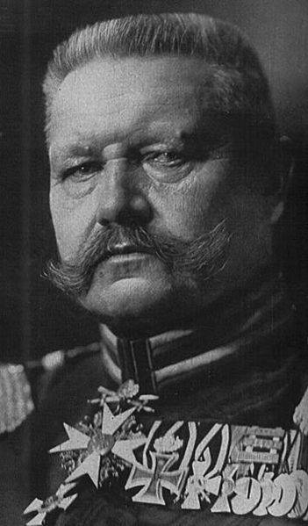
Presidential Elections 1932
Hindenburg up for re-election
Hitler runs as Hindenburg’s opponent
Hitler loses.
HOWEVER
Hindenburg still not happy with the Parliament and calls another election

Slide 9
1932 Elections
JULY
NAZIs get the most seats with over 13 million votes.
Hitler demands the Chancellorship as the leader of the political party with the most seats in the Reichstag.
The sitting Chancellor refused and asked Hindenburg to call another election.
NOVEMBER
NAZIs still win but with only 196 seats

Slide 10
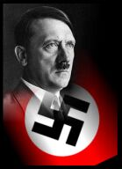
Hitler Chancellor - 1933
Hindenburg wanted to be able to control Hitler and the NAZIs.
Hitler was appointed Chancellor in January.
By February, he called new elections.

Slide 12
Nazism
1. The theory of the “Master Race”
A) The Aryan race was considered the best. It had not been “interbred” with other “inferior” races. Germans were descendants of the Aryan race.
B) Germans must keep their race pure in order to become the “Master Race”
C) Germans were too crowded in their own space and needed extra space “Lebensraum”

Slide 13
2. Anti-semitism
A) Nuremberg Laws (1935)
Reich citizen act: “No Jew can be a Reich citizen”
Law for the protection of German Blood and German Honour: “marriages between Jews and citizens of German or kindred blood are hereby forbidden”

Slide 15
2. Anti-semitism
B) Restrictions 1933-1939:
Jews were forbidden to practice many professions (medicine, teaching, etc)
Limits on the number of Jews in schools (eventually reduced to 0)

Slide 16
2. Anti-Semitism
C) Kristallnacht (1938)
Windows of Jewish shops, homes and synagogues were smashed.
A lot of looting and destructions took place

Slide 20
2. Anti-Semitism
D) Concentration camps:
Created immediately after Hitler became Chancellor
Meant to punish and torture political opponents

Slide 21
2. Anti-Semitism
E) Extermination camps:
Created to systematically kill millions, primarily by gassing, but also in mass executions and through extreme work under starvation conditions.

Slide 23
Expansion
of the
Nazi Party

Slide 24
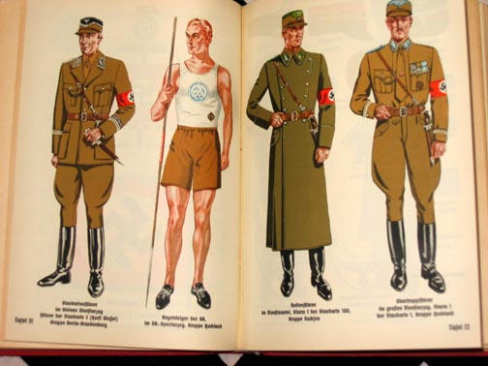
1. STURMABTEILUNG
aka the Brownshirts because their uniform was brown
NAZIs own political army
Made up of men who were also unhappy with the outcome of the Treaty of Versailles
Goal was to discourage other political groups from meeting – usually done violently

Slide 25
2. SS (Schutzstaffel)/ Secret Police: created in 1926
AKA Gestapo
SA expanded to reach into other parts of Germany

Slide 26
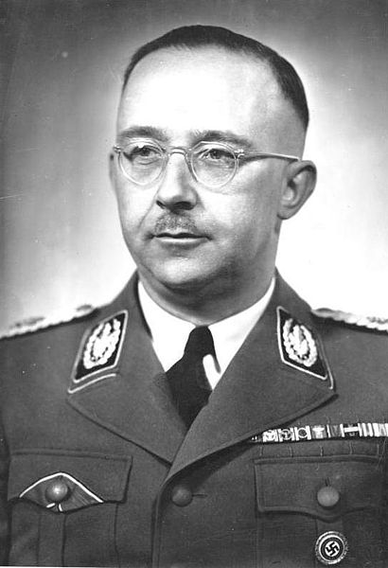
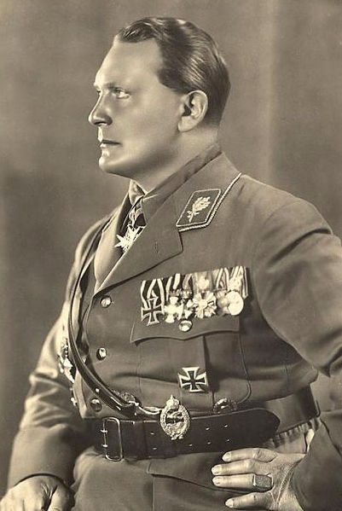
Two Faces of the NAZI Security Forces
Heinrich Himmler, Oversaw all security forces within the country
Hermann Goring, SA Commander and eventually led the Luftwaffe

Slide 27
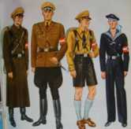
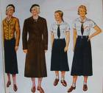
3. Creation of the Hitler Youth & German Girls’ League

Slide 28
4. Formation of the Nazi Student League, Teachers’ League, Women’s League, Physician’s League

Slide 29
Hitler’s attack on the Treaty of Versailles
Slowly but surely, Hitler began to break many of the rules set out by the Treaty of Versailles
1. 1935: Begins rearmament- introduces conscription, rebuild the navy
2. 1936: Reoccupies the Rhineland
3. March 1938: The Anschluss: Germany & Austria join together
4. September 12 1938: Hitler asks that Sudetan Germans to get their own government.

